Slide 1
Study and implementation of wired intercom
GUIDED BY,
Mrs.A B Evanjalin , M.E AP/ECE
TEAM MEMBERS,
Nagaraj.K,(963520106031)
Livingston.I,(963520106029)
Amat Raseeth.J,(963520106006)

Slide 2
ABSTRACT
This project introduces a wired intercom system designed for seamless communication in various environments
It involves strategically installing master stations and substations, selecting appropriate wiring and power supply options, and integrating with existing infrastructure
The system aims to provide dependable and user-friendly communication tailored to specific needs,
Enhancing connectivity within residential and commercial spaces.

Slide 3
INTRODUCTION
A wired intercom system is a communication system that uses physical wires to transmit audio signals between different locations within a building or property.
A wired intercom system has a central unit connected to multiple stations in different areas. Users talk by pressing a button or speaking into a microphone, and the audio travels instantly through the wires.
Wired intercom systems are known for their reliability, security,and clear audio quality for use in where effective communication is essential.

Slide 4
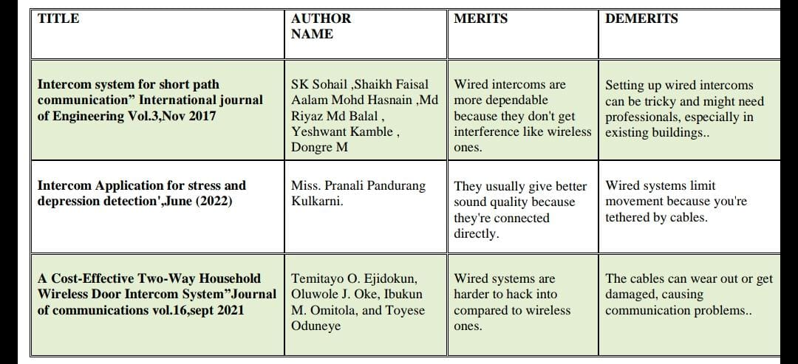
LITERATURE SURVEY

Slide 5
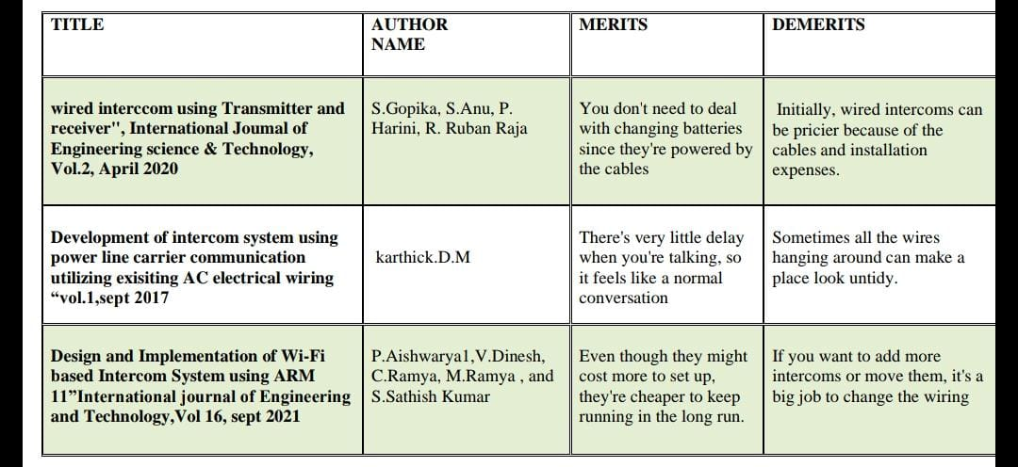

Slide 6
EXISTING SYSTEM
Telegraph Systems:
Telegraph systems were used for long-distance communication before the
advent of telephones.
In some cases, telegraph systems were adapted for intercom communication within larger buildings or facilities, allowing messages to be sent and received electronically between different rooms or departments.
Mechanical Call Systems:
Mechanical call systems utilized mechanisms such as bells, buzzers, or whistles to signal for attention or summon individuals to a specific location.
For example, pull cords connected to bells or buzzers were used in hospitals or residential buildings to alert staff or caregivers when assistance was needed.

Slide 7
DISADVANTAGES
Wired intercoms suffer from limited mobility due to the physical cables, constraining movement within a fixed range
If you want to change or add to the system later, it can be tough and might cost more
So basically, wired intercoms can be a bit inflexible and tricky to deal with compared to wireless ones.

Slide 8
PROPOSED SYSTEM
The wired intercom system uses physical wires to connect stations for reliable and secure communication. Each station has a microphone and speaker, with a central unit managing communication and integration with security systems. It's expandable for larger areas.

Slide 9
BLOCK DIAGRAM
Telephone ID 1
Telephone ID 2
Central control units
Power supply
unit
Telephone ID 3
Telephone ID 4

Slide 10
ADVANTAGES
Reliable communication without interference.
Enhanced security against hacking.
Consistent performance unaffected by environmental factors.
No dependency on batteries for operation.
Minimal signal degradation over long distances.

Slide 11
HARDWARE IMPLEMENTATION
CENTRAL CONTROL UNIT :
(i) EPABX, these technologies work together to convert voice signals into electrical signals, process them as needed, and transmit them over the EPABX system
(ii)Signals are sent to the right places in the network, letting people talk to each other on phone calls
HANDSETS :
(i) Handsets are the parts of phones you hold up to your ear and mouth to talk and listen.
(ii) They have speakers so you can hear, and microphones so others can hear you

Slide 12
POWER SUPPLY :
(i) In a wired intercom system,the power supply is crucial for providing electricity to components like master stations, substations, and amplifiers.
(ii) It converts AC from the mains into DC, which is distributed through the wiring to each power station or device. It may also offer protection against electrical faults and regulate voltage for system stability

Slide 13
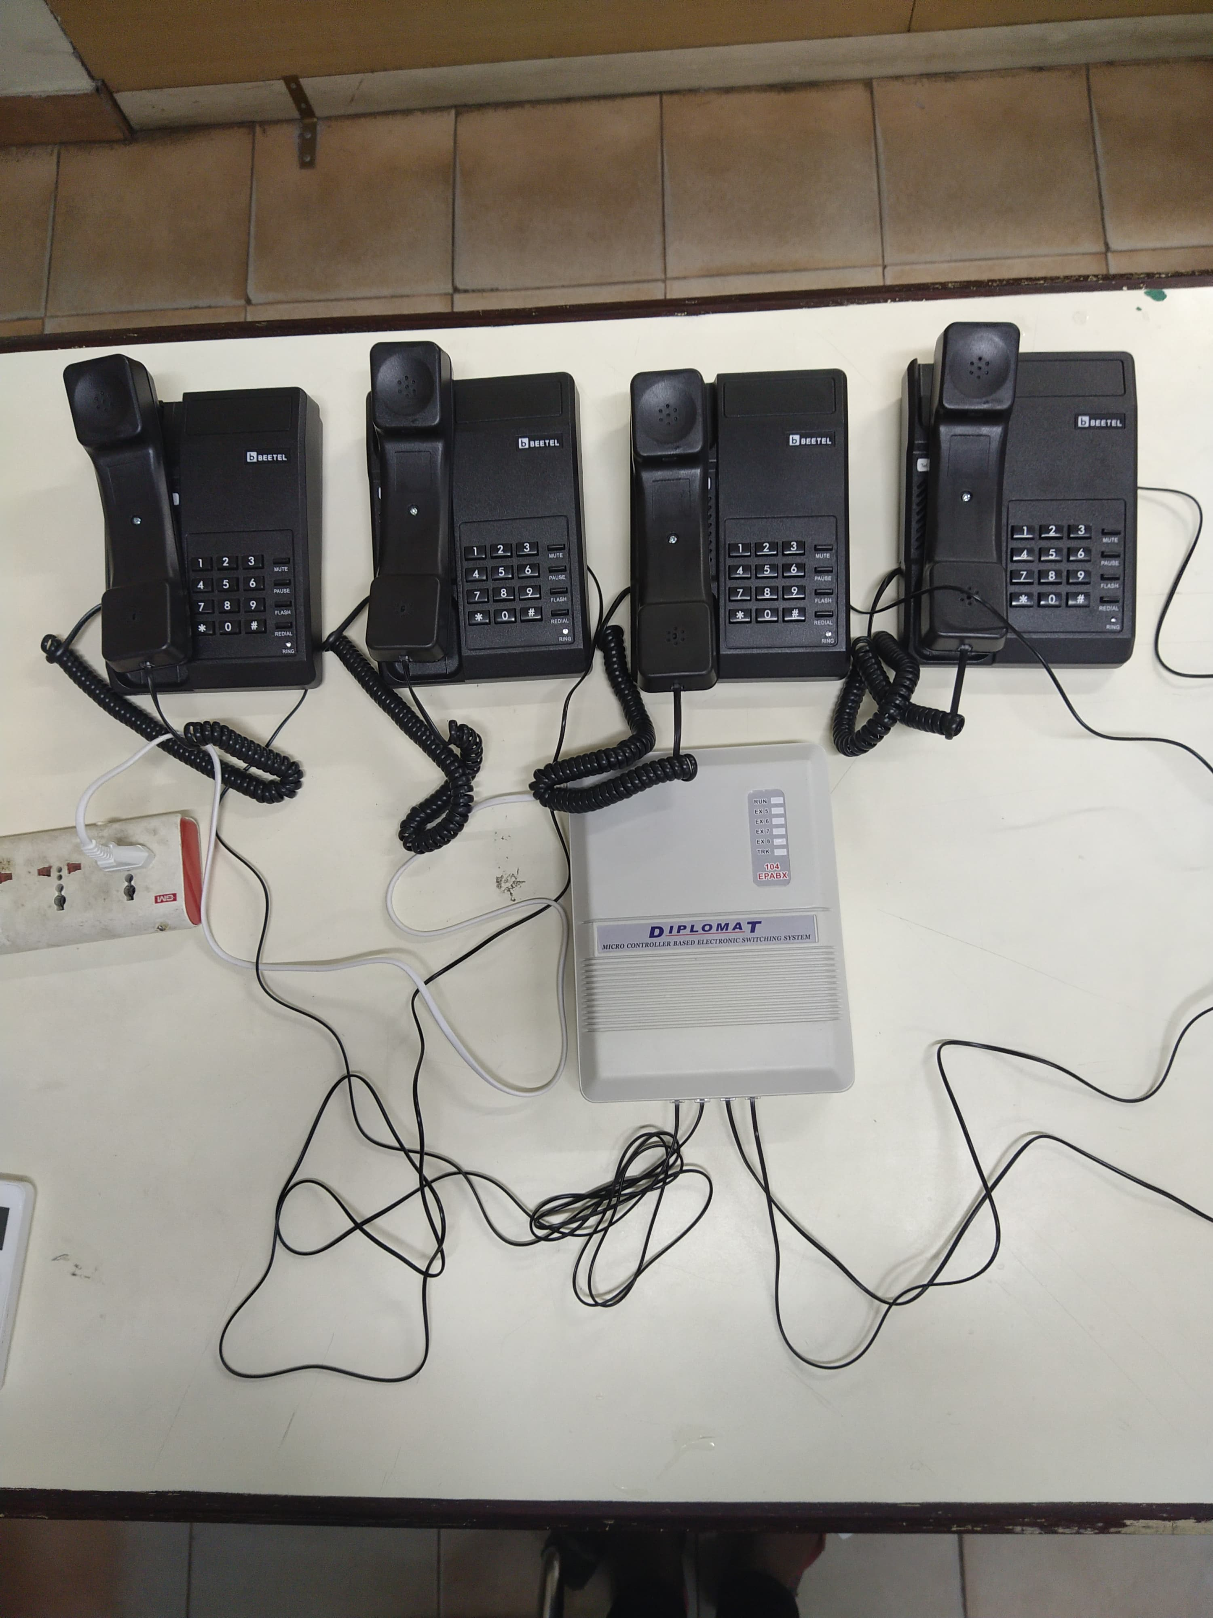
HARDWARE OUTPUT

Slide 14
EXPLANATION
A wired intercom system is like a network of phones connected by wires.
You have a main unit and other units placed around.
When you want to talk, you press a button, and your message goes through wires to the right place.
These systems are handy for places like homes, and hospitals where people need to talk to each other easily.

Slide 15
RESULT & DISCUSSION
The proposed system is designed in which intercom system helps people to talk and stay safe in buildings. It lets you to communicate clearly and quickly between different spots like rooms or areas
It improves security by letting you screen visitors and communicate during emergencies.

Slide 16
CONCLUSION
The wired intercom system is dependable, secure, and easy to use.
Installing it is straightforward and works well in different places.
It has great features and can grow with your needs, making sure it stays reliable for a long time.

Slide 17
The wired intercom system offers reliable communication, enhanced security, and convenient. functionality.
When choosing between wired and wireless intercoms, it's important to think about what you really need.

Slide 18
FUTURE SCOPE
FUTURE SCOPE
Wired intercoms offer enhanced security, making them ideal for sensitive environments.
They can integrate seamlessly with other building systems for improved management.
Future systems may feature improved audio and video quality for clearer communication and identification.

Slide 19
Wired intercoms can be remotely monitored and managed, facilitating easier maintenance.
Manufacturers are likely to develop modular solutions for easier installation and customization to meet various needs.

Slide 20
REFERENCES
[1] SK Sohail ,Shaikh Faisal Aalam Mohd Hasnain ,Md Riyaz Md Balal , Yeshwant Kamble , Dongre M.”Intercom system for short path communication” International journal of Engineering Vol.3,Nov 2017
2]Miss. Pranali Pandurang Kulkarni," Intercom Application for stress and depression detection',June (2022)
3]Temitayo O. Ejidokun, Oluwole J. Oke, Ibukun M. Omitola, and Toyese Oduneye1.” A Cost-Effective Two-Way Household Wireless Door Intercom System”Journal of communications vol.16,sept 2021

Slide 21
4]S.Gopika, S.Anu, P. Harini, R. Ruban Raja," wired interccom using Transmitter and receiver", International Joumal of Engineering science & Technology, Vol.2, April 2020
5]karthick.D.M “ Development of intercom system using power line carrier communication utilizing exisiting AC electrical wiring “vol.1,sept 2017
6] P.Aishwarya1,V.Dinesh, C.Ramya, M.Ramya , and S.Sathish Kumar.” Design and Implementation of Wi-Fi based Intercom System using ARM 11”International journal of Engineering and Technology,Vol.16,sept 2021.

Slide 22
THANK YOU

